Slide 1
Safety & Risk Services
MIGUEL DELGADO
Overview on:
Worker’s Compensation Process/FAQ’s
Waiting Period
Payment under Worker’s Comp
Leave Policies

Slide 2
Safety & Risk Services
ACCIDENT REPORTING TRAINING

Slide 3
Purpose for the Training- To educate management, supervisors, and employees of the proper policies and procedures to follow in regards to work-related accidents.

Slide 4
WHY IS IT IMPORTANT TO PROPERLY REPORT WORK-RELATED ACCIDENTS?

Slide 5
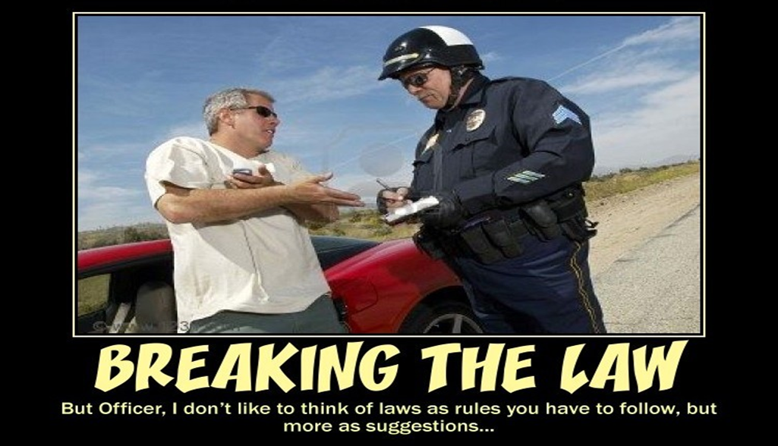
1- It’s the Law New Mexico Workers’ Compensation Administration- We can be fined for not correctly reporting Work-Related Accidents.

Slide 6
2- To Protect the Injured Worker
Properly reporting Work-Related Accidents protects the Injured Worker and preserves their rights under the New Mexico Workers’ Compensation Act.

Slide 7
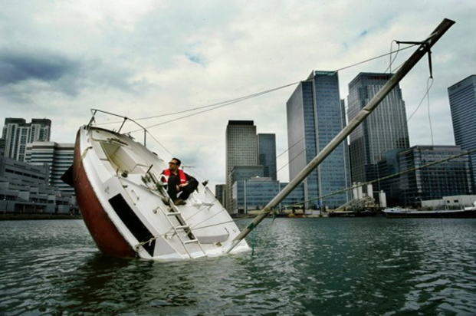
3- To Ensure a Smooth Workers’ Compensation Process

Slide 8
REPORTING PROCEDURES
1- All work-related accidents and/or illnesses must be reported to the employee’s immediate supervisor. (UNM Administrative Policy 3630 4.1)
Example- I am walking back to my office from the bathroom when I slip on a banana peel and fall down. I’m a little bit embarrassed, but I think I’m okay.
Should I tell anyone? Should I just wait to see how I feel tomorrow or how I feel in a few days?
I should report the incident to my immediate supervisor.

Slide 9
SO WHERE DO WE GO NEXT?
There are 2 possible actions to take once the employee has notified their supervisor of a work-related accident or illness.
WHY IS THAT?
Because you have 2 types of incidents-
INCIDENT TYPE #1- No formal Medical Treatment is needed or planned.
INCIDENT TYPE #2- Formal Medical Treatment is needed or planned.

Slide 10
2- All work-related accidents NOT requiring formal Medical Treatment are to be documented by having the employee complete a Notice of Accident Form as soon as possible, but no later than fifteen (15) days after the injury occurs. (UNM Administrative Policy 3630 4.1.1)
What is the formal method of reporting incidents not requiring formal Medical Treatment?
NOA Form- Notice of Accident
By law, NOA forms have to be posted in a prominent location in each place of employment.

Slide 11
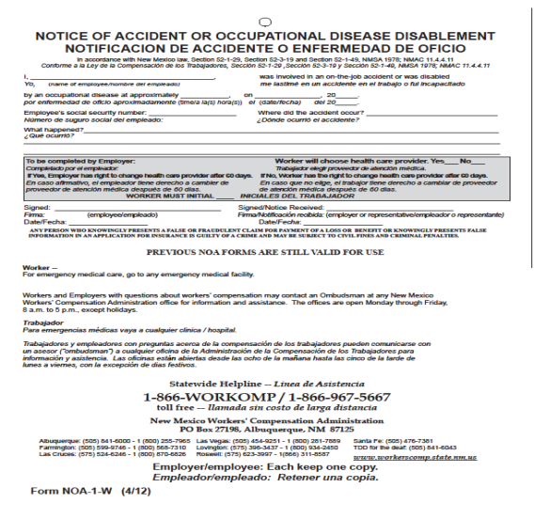

Slide 12
KEY ITEMS TO REMEMBER ABOUT NOTICE OF ACCIDENT FORMS
Both the Injured Worker and the Supervisor/University Representative must sign and date the form.
The employee should receive a copy of the form once signed by the Supervisor.
The form should be sent to Safety & Risk Services.
The main purpose of the NOA is to preserve the rights of an injured worker under the NM Workers’ Compensation Act.
Completed NOA forms are sent to State of NM Risk Management Division so the incident/potential injury is documented.

Slide 13
Example #1- Mike is lifting a heavy box of paper and feels a slight strain in his back. He thinks he is okay and decides to not mention it to anyone. About a month later, he notices that his back just hasn’t felt right. He remembers how he tweaked it about a month before when moving a box of paper. He goes to his doctor and finds out that he has a herniated disc that is pressing on a nerve. He then reports this to his supervisor.
Example #2- Mike is lifting a heavy box of paper and feels a slight strain in his back. He thinks he is okay but decides to report the incident to his supervisor. His supervisor has him complete a Notice of Accident Form and submits the form to SRS. About a month later, he notices that his back just hasn’t felt right. He remembers how he tweaked it about a month before when moving a box of paper. He goes to the doctor and finds out that he has a herniated disc that is pressing on a nerve. He then reports this to his supervisor.

Slide 14
3- All work-related accidents requiring formal Medical Treatment need to be reported to the Department of Safety & Risk Services within 24 hours from the time the employee’s supervisor was informed of the incident. (UNM Administrative Policy 3630 4.1)
What is the formal method of reporting those incidents?
E1.1- First Report of Accident Form

Slide 15
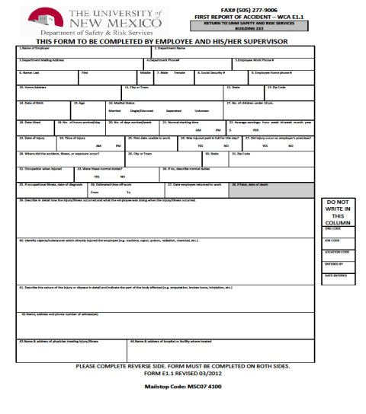

Slide 16
KEY ITEMS TO REMEMBER ABOUT E1.1 FIRST REPORT OF ACCIDENT FORMS
- Form must be signed by both the Employee and Supervisor.
Please have the Employee use their actual SSN#.
Please indicate where Medical Treatment was sought or will be sought.
If the Supervisor believes the claim may be a false claim, please still complete the E1.1 Form and then notify SRS directly of your concerns. We are required by law to file Workers’ Compensation claims even if we have doubts about the legitimacy of the claim. SRS will pass any concerns/evidence along to the insurance company.

Slide 17
1- All Work-Related Accidents and/or Illnesses must be reported to the employee’s immediate supervisor.
2- For accidents not requiring formal Medical Treatment, please have the employee complete a Notice of Accident Form.
3- For accidents requiring formal Medical Treatment, please have the employee complete a E1.1 First Report of Accident Form.

Slide 18
THE BIGGEST MISTAKES
1- Failure to complete required forms in a timely manner.
2- Incomplete forms/missing information.
3- Failure to notify SRS and Payroll if an employee has missed five (5) or more scheduled days of work due to a work-related injury. (UNM 3630 4.3) If more than 7 calendar days are missed, then it becomes a LOST TIME claim.
4- Failure to reach out to SRS and ask questions if unsure about the Workers’ Compensation Process.

