Slide 1

Title IX and Sexual Misconduct
UNM Staff and Faculty Responsibility

Slide 2
Title IX
Title IX protects against gender discrimination and provides for equal opportunity for students to pursue education and have equal and safe access to all of a school’s programs, facilities, etc
Typically thought of only in relation to athletics
Mandated through Office for Civil Rights (OCR) in the US Dept of Education
All institutions receiving federal funds or providing federal financial aid to students must adhere to Title IX

Slide 3
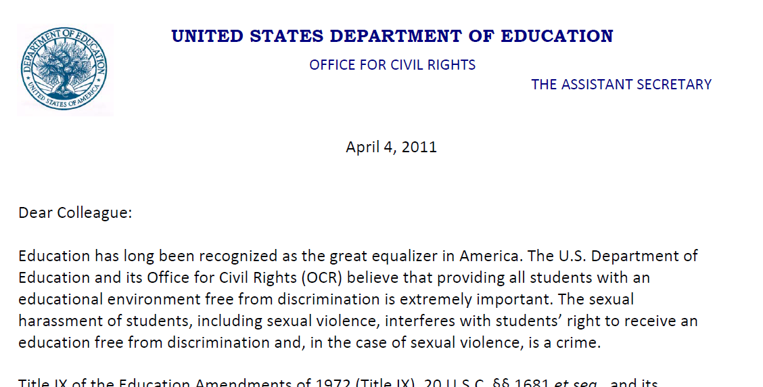
Dear Colleague Letter (DCL)
April 2011
http://www2.ed.gov/about/offices/list/ocr/letters/colleague-201104.pdf

Slide 4
Dear Colleague Letter (DCL)
April 2011
OCR and the Dept of Education provided guidance on Sexual Misconduct to Universities following investigations into Universities’ handlings of charges of Sexual Assault and other types of Sexual Misconduct
Many schools and universities were ‘handing off’ sexual assault allegations to criminal justice offices without conducting a Title IX investigation
Sexual assault and sexual misconduct severely impact and limit a student’s ability to access a school’s programs and facilities.
Sexual Misconduct is a form of gender discrimination
Universities must take action regarding sexual misconduct to ensure compliance with Title IX

Slide 5
Dear Colleague Letter (DCL)
April 2011
Sexual assault and other forms of sexual misconduct fall under a sexual harassment umbrella – violation of Title IX and civil rights
Every school must have a Title IX Coordinator
If a school knows or reasonably should have known of sexual misconduct, then MUST act
Investigatory Component

Slide 6
Sexual Misconduct - Terms
Sexual Misconduct is the “umbrella” term for sexual harassment, sexual and/or gendered violence, sexual exploitation, stalking, etc.
*Generally* sexual harassment is conduct of a sexual nature that is so severe and/or pervasive that it interferes with a person’s ability to learn or work
  Sexual Harassment is the “umbrella” term per OCR

Slide 7
Sexual Misconduct
Sexual Violence
Includes rape, sexual assault, or any sexual act without consent
  Consent being defined as a clear ‘yes’ either verbally or through action by both parties
  Consent cannot be given by someone who is incapacitated through sleep, drugs, alcohol, or certain physical or mental impairments
  Consent does not arise from coercion, force, incapacity, intimidation or threat

Slide 8
Sexual Misconduct
Gendered Violence
  Violence that would not occur if not for the person’s gender
Sexual Harassment
  unwelcome verbal, visual, or physical conduct of a sexual nature that is severe and/or pervasive and affects working or learning conditions or creates a hostile environment
Stalking

Slide 9
Sexual Misconduct
Sexual Exploitation
  Taking non-consensual advantage of another for the advantage or benefit of anyone other than the person being exploited
    Can include: non-consensual video or audio taping of sexual activity, sharing of video, audio or pictures, observing someone or allowing another to observe someone who is partially or fully undressed or who is engaged in sexual activity when there is a reasonable expectation that they would not be observed

Slide 10
Your Responsibility
Perceived as a person with “authority”
  Perceived by a reasonable person as able to take some action on behalf of UNM
  That action could just be reporting
When you hear an allegation or potential allegation
  You must report to OEO, Dean of Students or Sexual Assault Response Team

Slide 11
Talking Points
Confidentiality vs. Anonymity
  If you have to report, ensure the student knows who you will tell and what you will say
Stop! I have an obligation!
Believe them and listen
Provide resources (UNMPD, OEO, SHAC, WRC, SART, DOS)

Slide 12
Talking Points
Next steps: you will disclose to OEO, DOS, etc. They will contact the student to request information and inform them of their rights and options
Students are NOT required:
  to share additional information
  to go to the police
  to participate in a process or the investigation
    OEO and DOS will do our best to ensure that the student’s needs and desires are fulfilled
    We reserve the right to investigate in order to meet our obligations to all students
Retaliation is strictly prohibited and UNM can issue no-contact orders and even ban people from campus
Call 911 from any campus phone for UNMPD

Slide 13
Scenarios
Advisement
  You are seeing a student for advisement. She tells you she needs to drop a class even though it is past the drop/add date. When you tell her that she needs this class to graduate on time and ask her if she could stay in the class, perhaps requesting extra credit, she becomes very agitated and tearful and says she cannot stay in a class with someone who attacked her.

Slide 14
Scenarios
Advisement
  Step 1: When she becomes agitated – STOP! I have an obligation! If she continues…
  Step 2: listen and believe (no personal opinion)
  Step 3: offer resources (refer and connect)
  Step 4: tell her who you will tell, what you will say and what the next steps are
  Step 5: re-assure her that UNM takes these matters very seriously and she is protected from retaliation
  Step 5: call or email OEO or DOS with the report and be available for any follow up questions.

Slide 15
Scenarios
Student Employee
  A student employee has been late consistently over the past several weeks. When you speak with him about this issue, he tells you that he’s been trying to avoid his ex, who will not leave him alone.

Slide 16
Scenarios
Student Employee
  Step 1: At this point it is too late to STOP! I have an obligation, advise him that you will have to disclose the potential stalking/sexual harassment.
  Step 2: offer resources (refer and connect)
  Step 3: tell him who you will tell, what you will say and what the next steps are
  Step 4: re-assure him that UNM takes these matters very seriously and he is protected from retaliation
  Step 5: call or email OEO or DOS with the report and be available for any follow up questions.

Slide 17
Scenarios
Hotness
  You are in a lab where several students are completing projects. You overhear some male students talking about what makes “girls hot.” They are discussing breast size, weight, hips and buttocks. A female student is also present, working on her project, but not involved in the conversation.

Slide 18
Scenarios
Hotness
  Step 1: Interrupt the conversation and remind the students of appropriate behavior in the classroom/academic setting.
  Step 2: Report the occurrence to the chair of the department or appropriate supervisor.
  Step 3: Monitor the environment for repeat occurrences. If repeated, report to OEO or DOS.
  If a student tells you they are uncomfortable with that behavior, offer resources and advise them you will be reporting the concerns.

Slide 19
Things to consider
FERPA
HIPAA
Retaliation

Slide 20
Questions?
Office of Equal Opportunity
505-277-5251
oeounm@unm.edu
http://www.unm.edu/~oeounm

